Slide 1

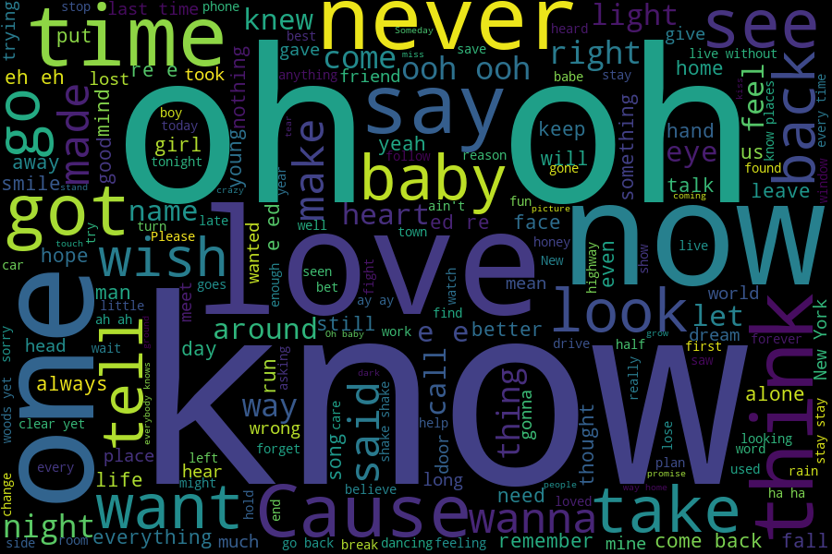


Slide 2

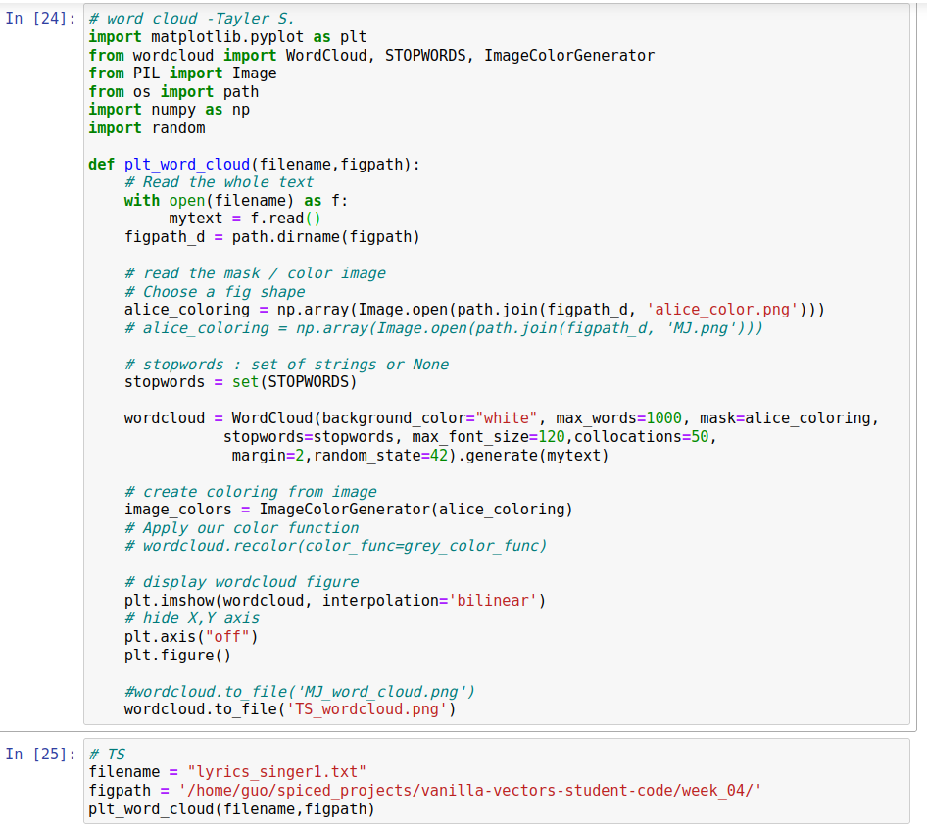


Slide 3



Slide 4
Thank you!

